Slide 1
Final presentation
Minesweeper.IO
By Vrijesh Patel and Tyler Wiggins

Slide 2
What is the purpose of our Minesweeper.IO application?
Sometimes life can get boring and we start to strive for entertainment or something that makes us use our big brain energy.
Our Minesweeper.IO website was made to challenge people and help them with critical thinking.
We added a time and score system to make the game competitive and more of a challenge for people.
We also made Minesweeper as a learning experience to learn how to make a .NET Core web application and use Microsoft SQL Server.

Slide 3
Tools used
Visual Studios C# .NET Core
MVC (Model- View - Controller)
JSON and JSON serializer
CSS
Bootstrap
SQL Server Object Explorer
Partial Views
Javascript
Console logs
Jquery
Ajax
Razer views
Rest Services
N-Layer Architecture
Right click functionality

Slide 4
Functionality
User can login
User can logout
User can register
User can play game
User can select difficulty
User can select board size

Slide 5
Functionality
User can save game
User can right click (to flag cells)
User can see time
User can see score
User can reset the game
User can load previous game

Slide 6
Technical Design
C# ASP.net Core
MYSQL for database management
Bootstrap
Github for sharing code

Slide 7
Known Issues and Challenges
User can not see top 10 high scores
CSS is not accurate in some cases
Register and login is not centered

Slide 8
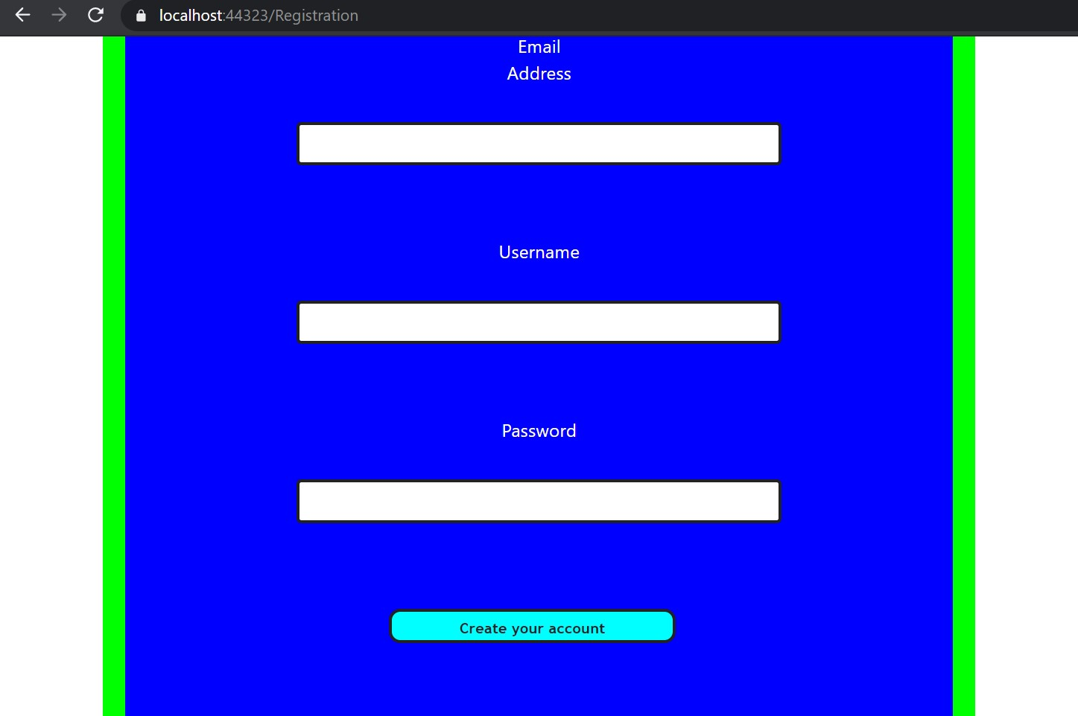
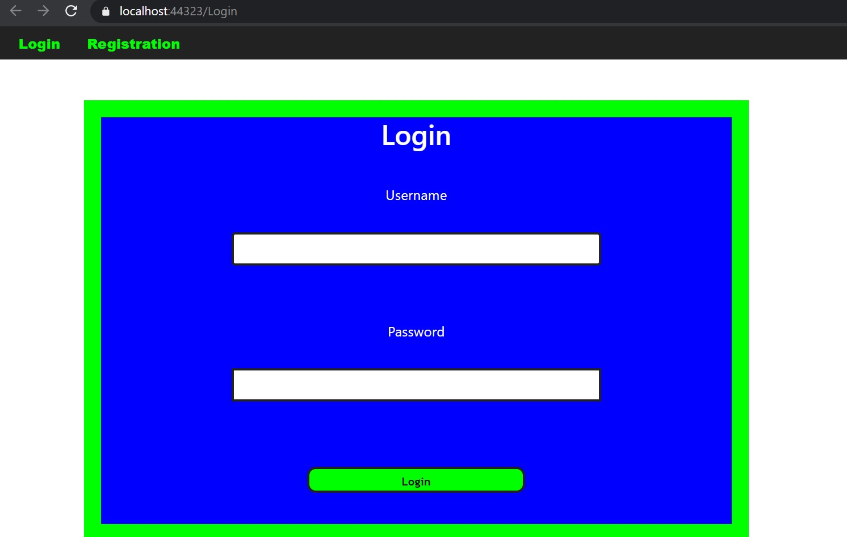
Register page
Login Page
Register and login pages that has data validation and checks if a user with the same data already exists.

Slide 9
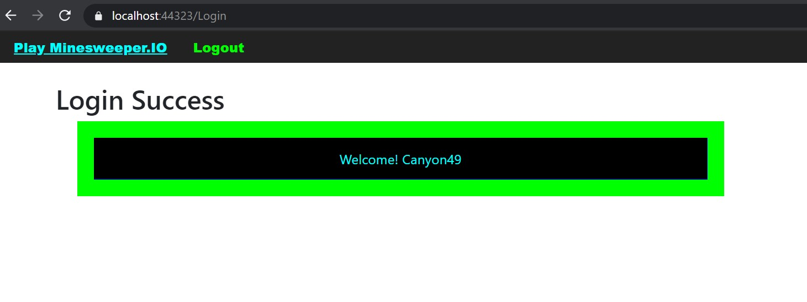
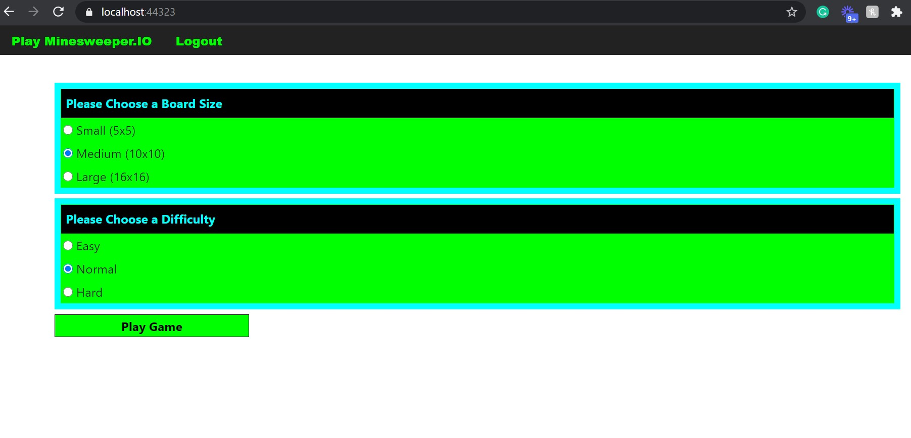
Register success page
Page to select the board size and the difficulty (Main Menu)
If successfully logged in, the navbar changes and a welcome message appears. Then the user can select the play option in the navbar.
User can choose the board size and difficulty, then click the Play Game button to start playing Minesweeper.IO.

Slide 10
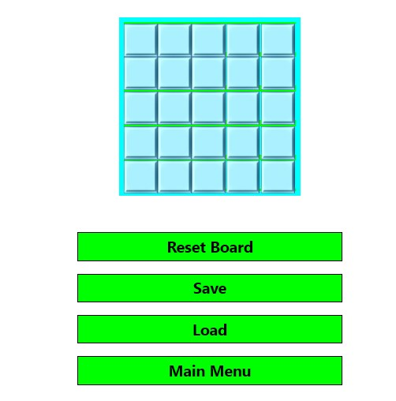
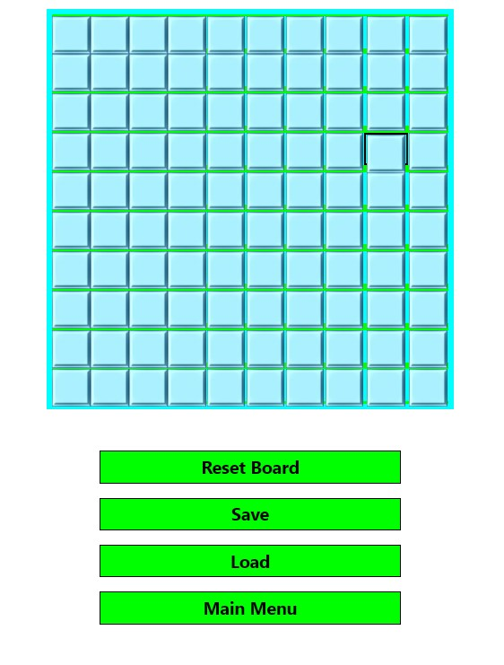
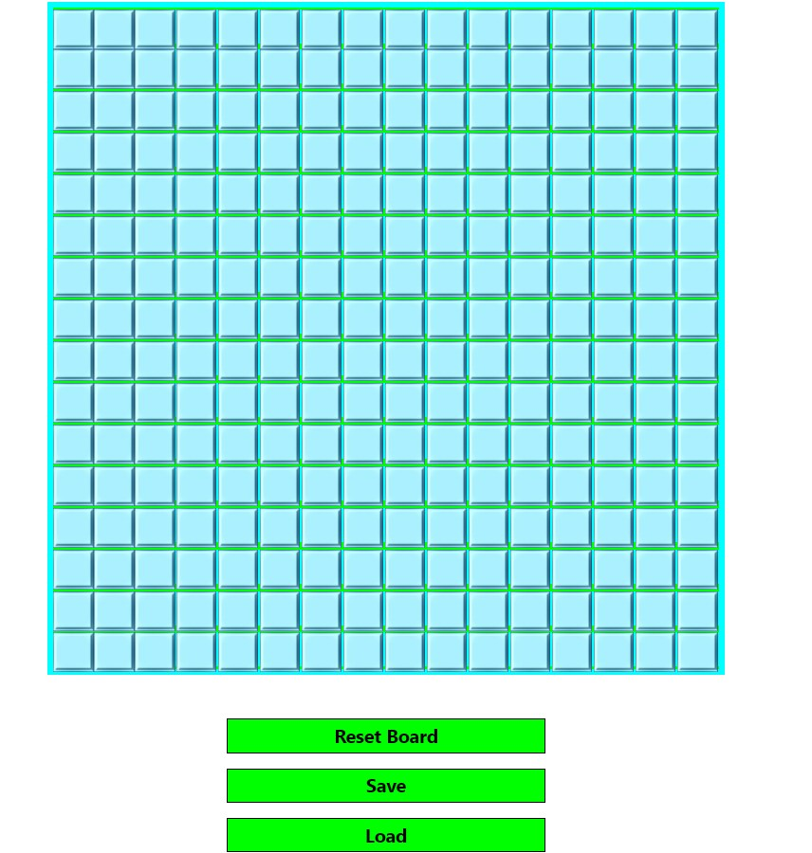
Game Board Sizes
Small game board 5x5
Medium game board 10x10
Large game board 16x16

Slide 11
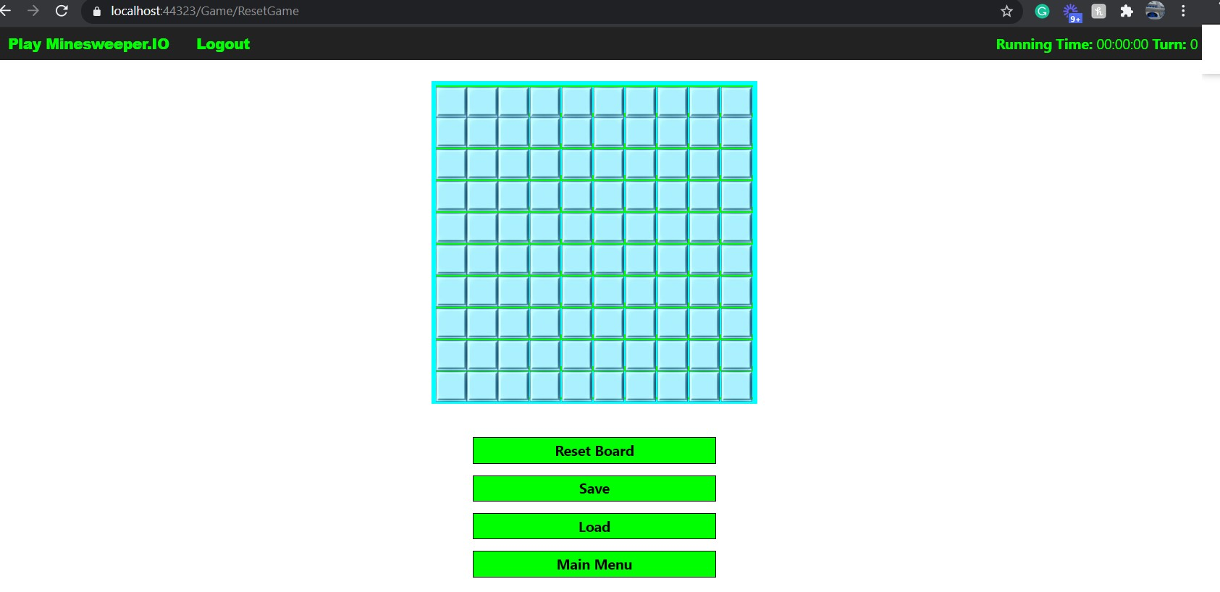
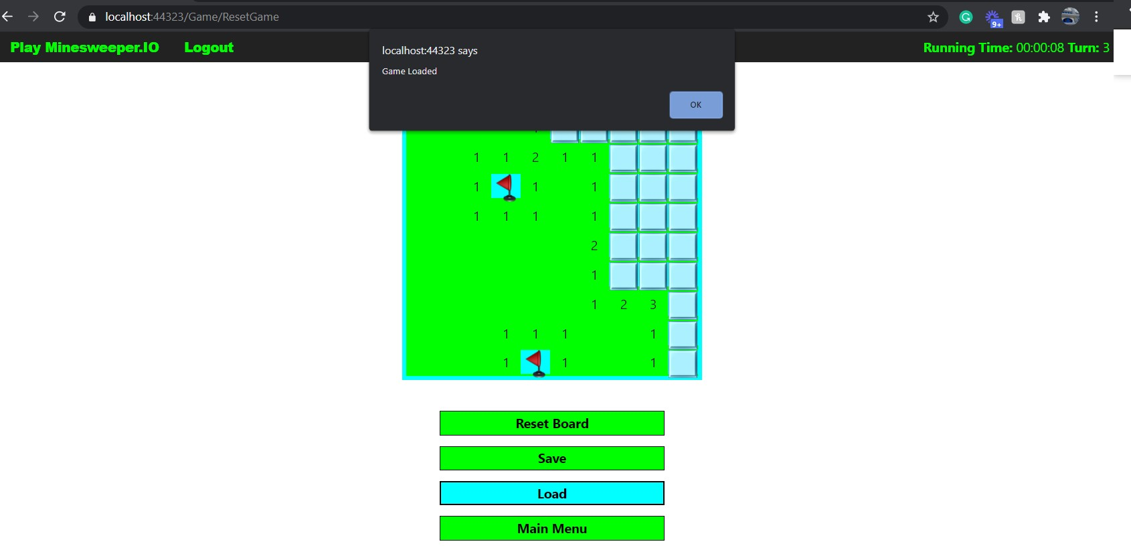
Full game board layout
Load game functionality
The time starts once the user clicks the first cell.
Once a user clicks the save game button, their time, moves, clicked/unclicked cells, flagged/unflagged cells, board size and difficulty will be saved. Then the user can click the load button to load a saved game (if it exists). Once they click OK in the message box, the time will resume.

Slide 12
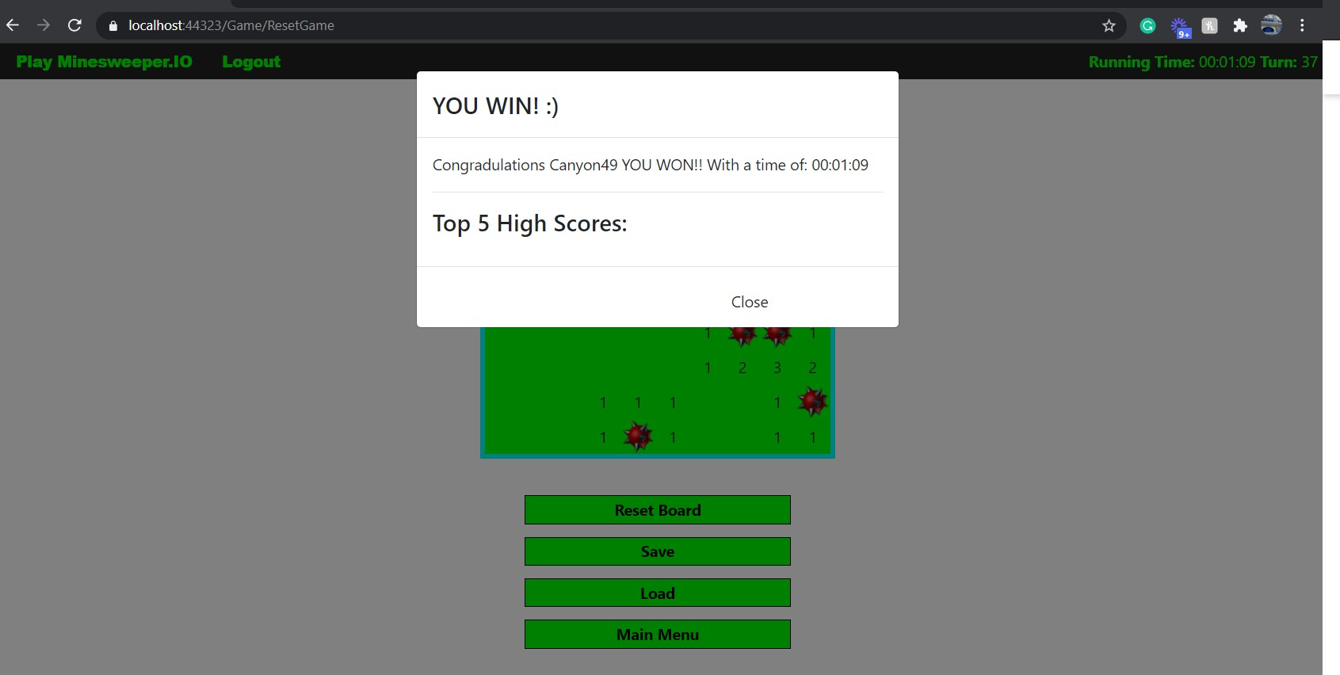
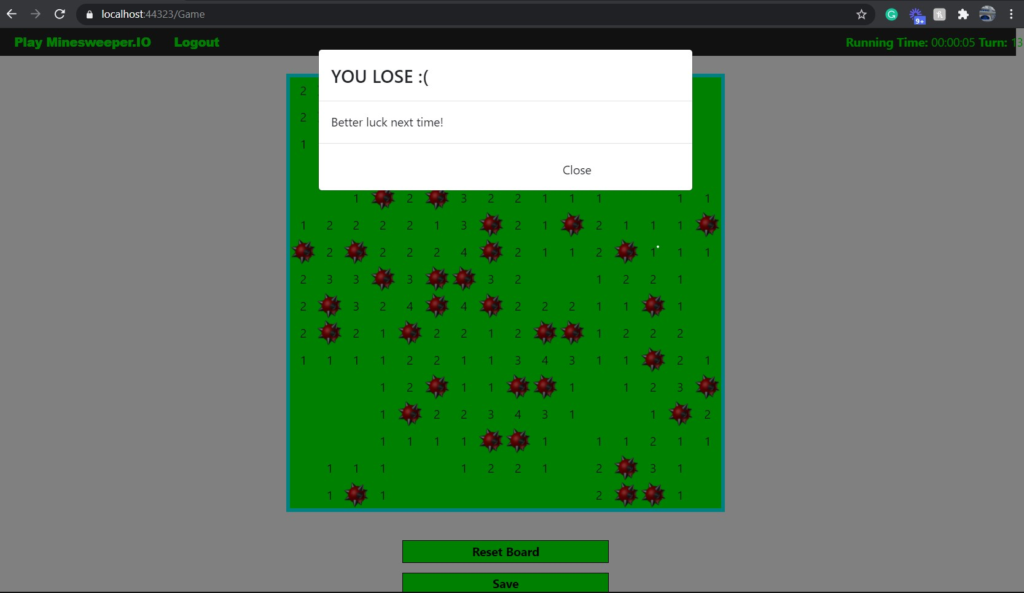
Win Message
Lose Message
If the user wins the minesweeper game, a win message will pop up that praises the user for winning. Then the top 10 high scores will show (Was not required + Currently not fully functional).
If the user loses all the mines will be displayed and a loose message will pop up and inform the user that they lost.

Slide 13
Thank You

